Slide 1
Board Chair Report
Sept. 12, 2024

Slide 2
Remington R. Williams Award Criteria
To be eligible for the award, recipients must:
Inspire growth in their peers
Advocate for the whole of the college experience
Make a positive impact on their university
Exhibit outstanding character
Have a minimum 3.0 GPA
Be a member of at least two student organization, and have held a leadership position in at least one of those organizations

Slide 3
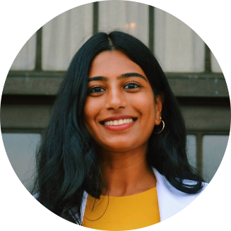
Remington R. Williams Award Recipient
Rithika Ginjupalli School of Medicine
"Rithika's pursuit of volunteerism, advocacy, and research, particularly in health equity, is an admirable quality that aligns with the award's criteria for outstanding student leaders. Rithika's initiatives extend beyond clinical settings, demonstrating her creativity and commitment to community service."

Slide 4
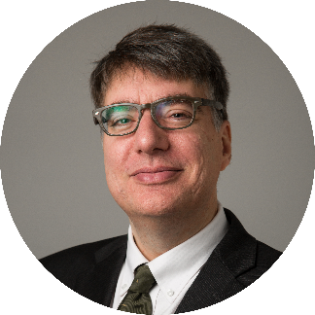
Curators' Distinguished Professor
Simon Friedman Professor
Pharmacy
Founded his lab at UMKC in 1999
Co-inventor on multiple U.S. and international patents for anti-cataract compounds
UMKC Trustees' Faculty Fellowship Award for Research recipient

Slide 5
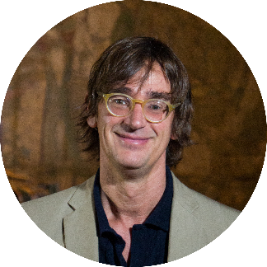
Curators' Distinguished Professor
Clancy Martin Professor
Philosophy
Published 14 books and 186 publications
Guggenheim Fellowship recipient
Awarded the 2024 UM System Thomas Jefferson Award

Slide 6
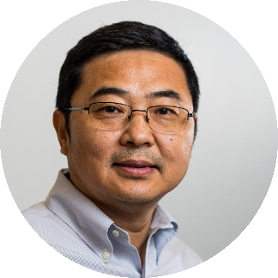
Curators' Distinguished Professor
Yong Wang
Professor
Oral and Craniofacial Science
Director of Craniofacial Bioengineering
Fellow of the American Institute for Medical and Biological Engineering
Fellow of the American Association for Dental, Oral and Craniofacial Research
Fellow of the Academy of Dental Materials

Slide 7
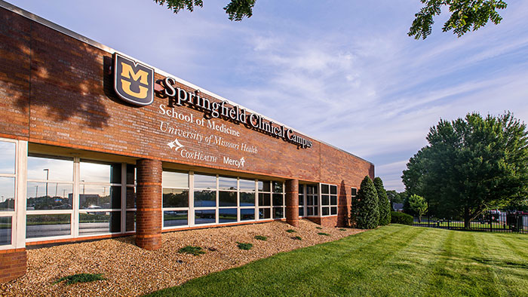
Board of Curators In Greene County
Notes:
Still need to update photos here –

Slide 8
Board of Curators Governance Report
Strategy
Resources
Leadership
Notes:
Still need to update photos here –

Slide 9
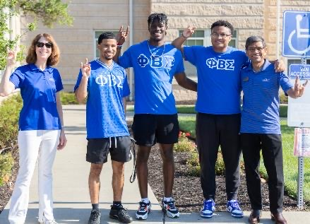
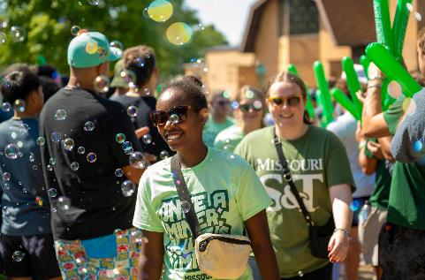
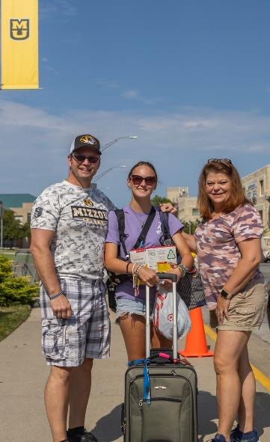
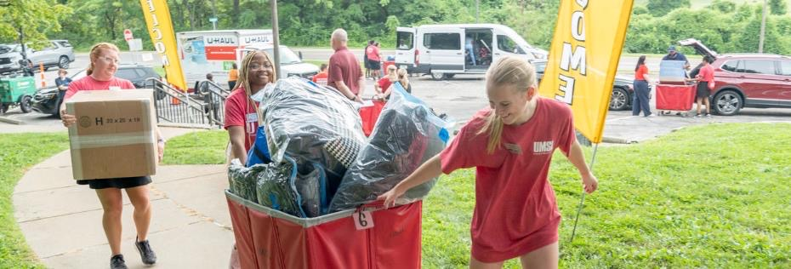

Slide 10
Missouri Momentum
Notes:
We can keep adjusting this

Slide 11
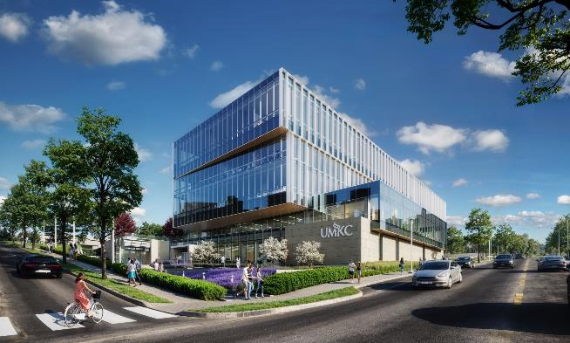
v
UMKC
Healthcare Delivery and Innovation Building
11

Slide 12
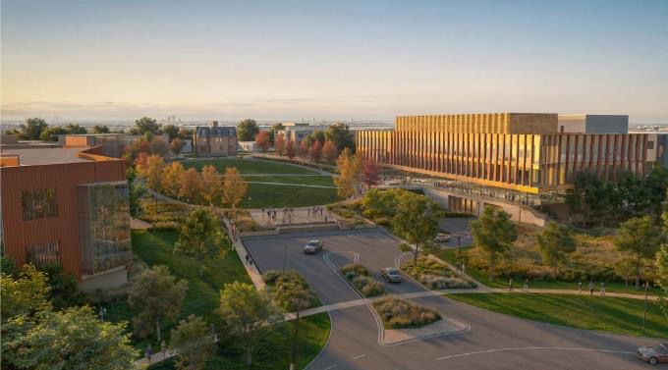
v
v
UMKC
Healthcare Delivery and Innovation Building
Missouri S&T
Bioplex
12

Slide 13
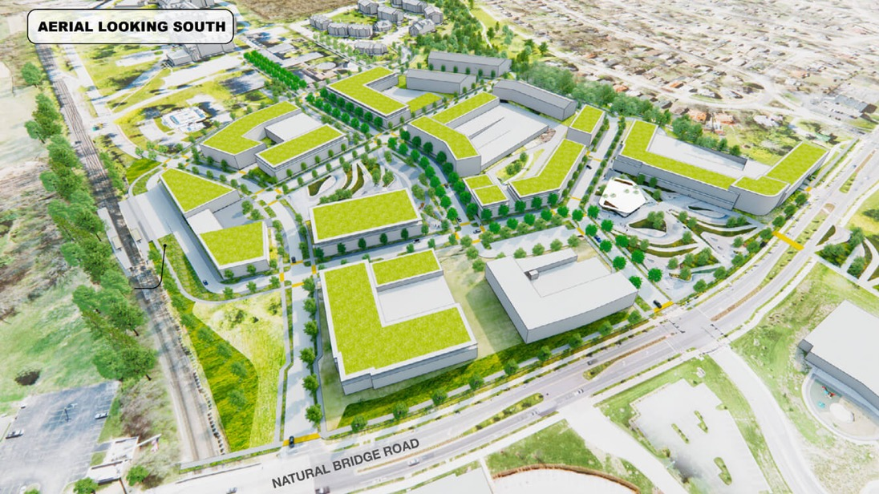
v
v
v
UMKC
Healthcare Delivery and Innovation Building
Missouri S&T
Bioplex
Transform UMSL Initiative
North St. Louis County Business & Workforce District
13

Slide 14
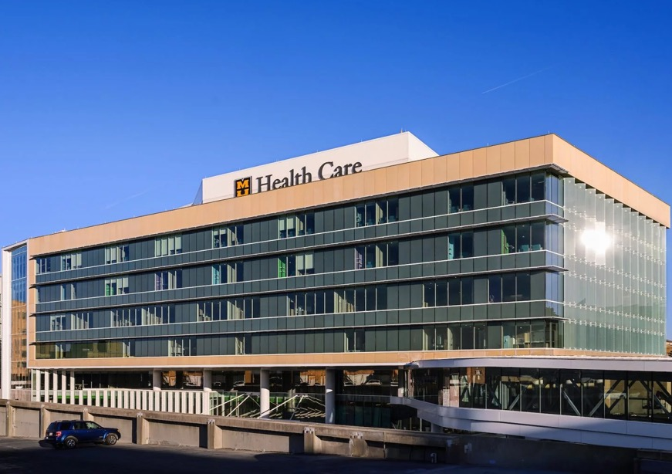
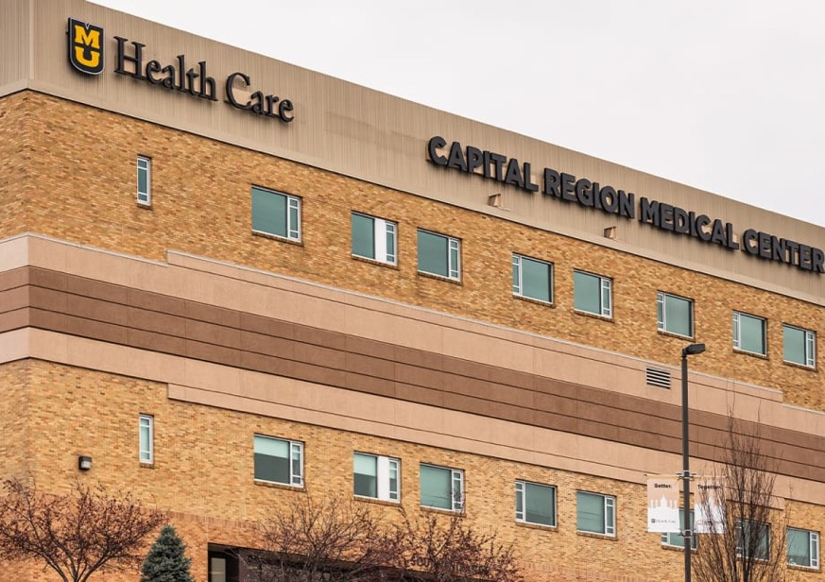
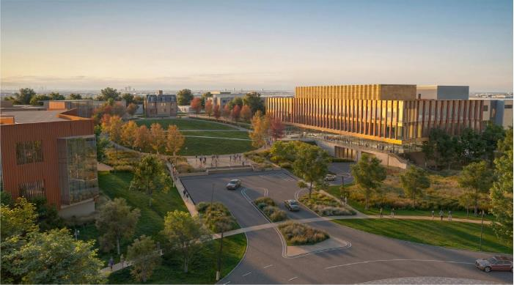
v
v
v
UMKC
Healthcare Delivery and Innovation Building
Missouri S&T
Bioplex
Transform UMSL Initiative
North St. Louis County Business & Workforce District
MU Health Care Children's Hospital
Capital Region Medical Center
14

Slide 15
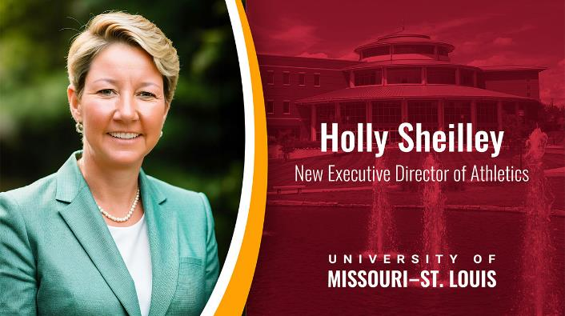
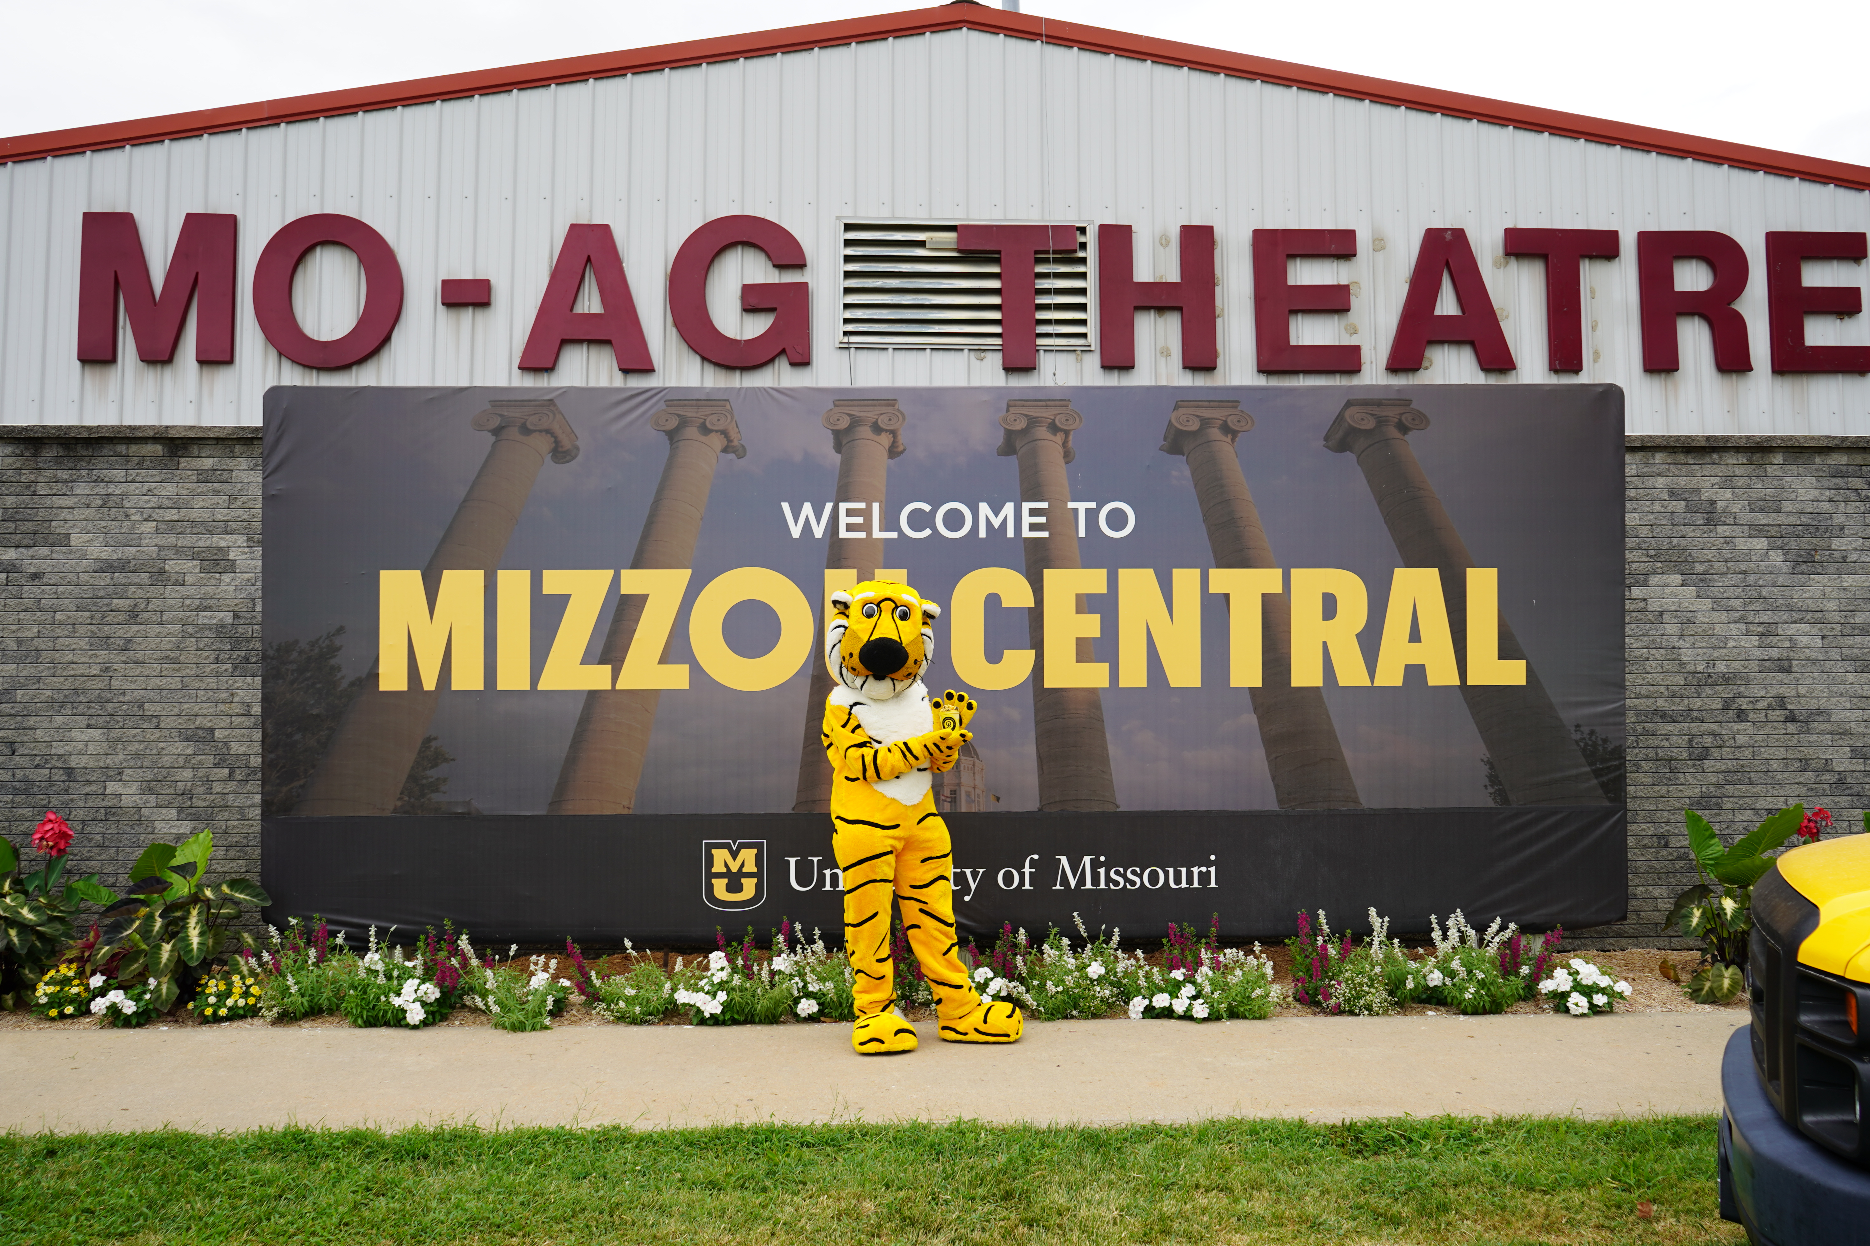
v
v
v
UMKC
Healthcare Delivery and Innovation Building
Missouri S&T
Bioplex
MU Health Care Children's Hospital
UMSL New Executive Director of Athletics
Holly Sheilley
University of Missouri at the State Fair
Capital Region Medical Center
Mizzou Central
S&T parade procession
15

Slide 16
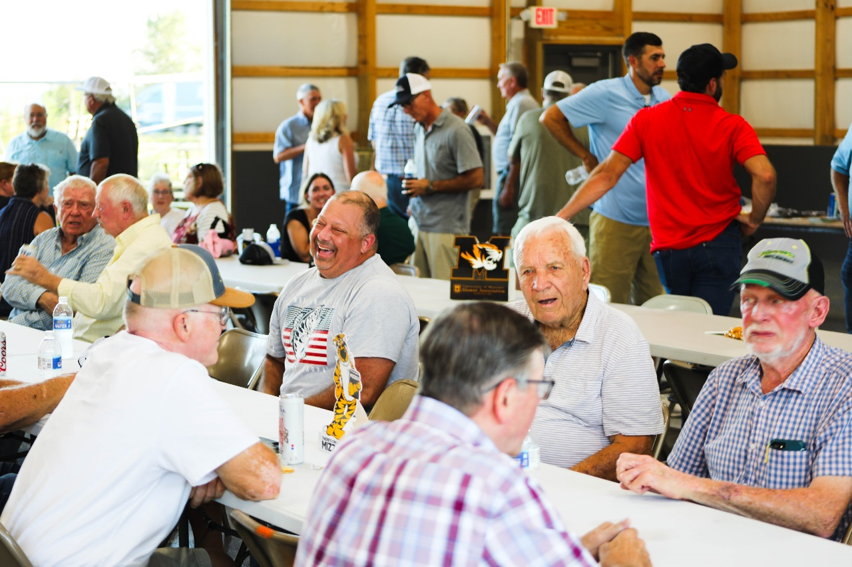
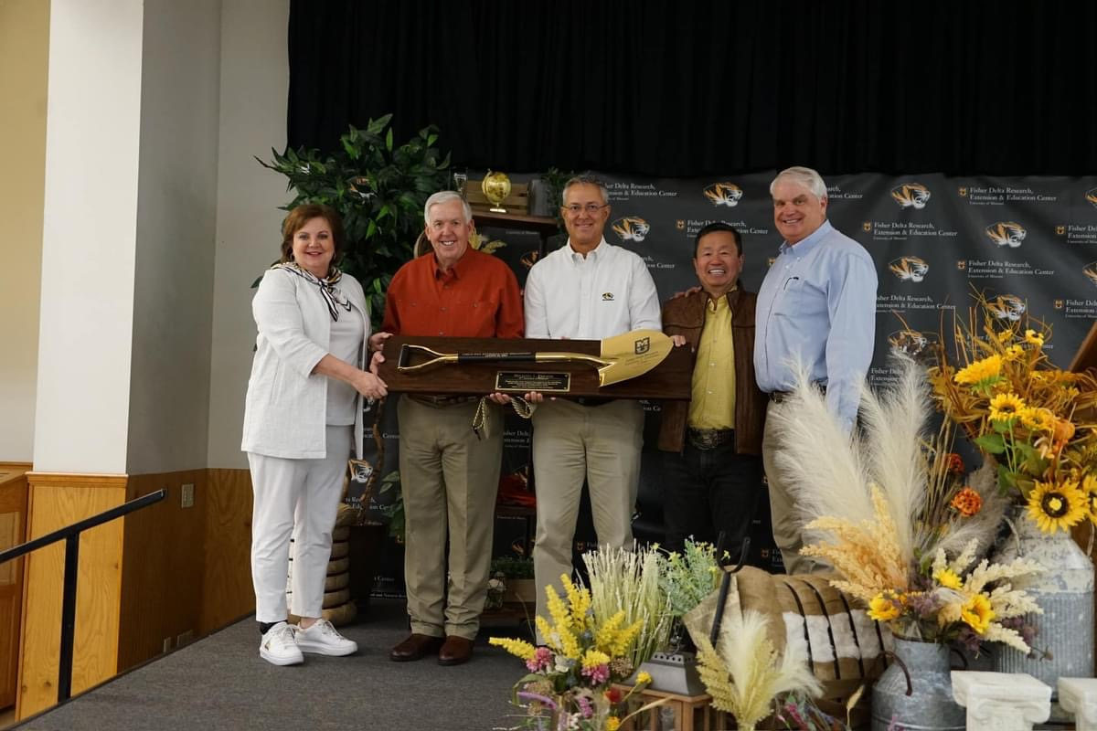
v
v
v
UMKC
Healthcare Delivery and Innovation Building
Missouri S&T
Bioplex
MU Health Care Children's Hospital
UMSL New Executive Director of Athletics
Holly Sheilley
University of Missouri at the State Fair
MU Extension & CAFNR
Capital Region Medical Center
Mizzou Central
Graves-Chapple field day
S&T parade procession
Fisher Delta Center field day
16

Slide 18
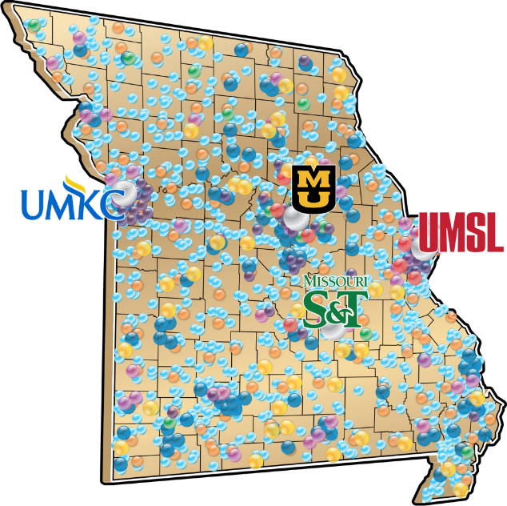
We are Missouri, Missouri is us.
Notes:
We can keep adjusting this

